Slide 1
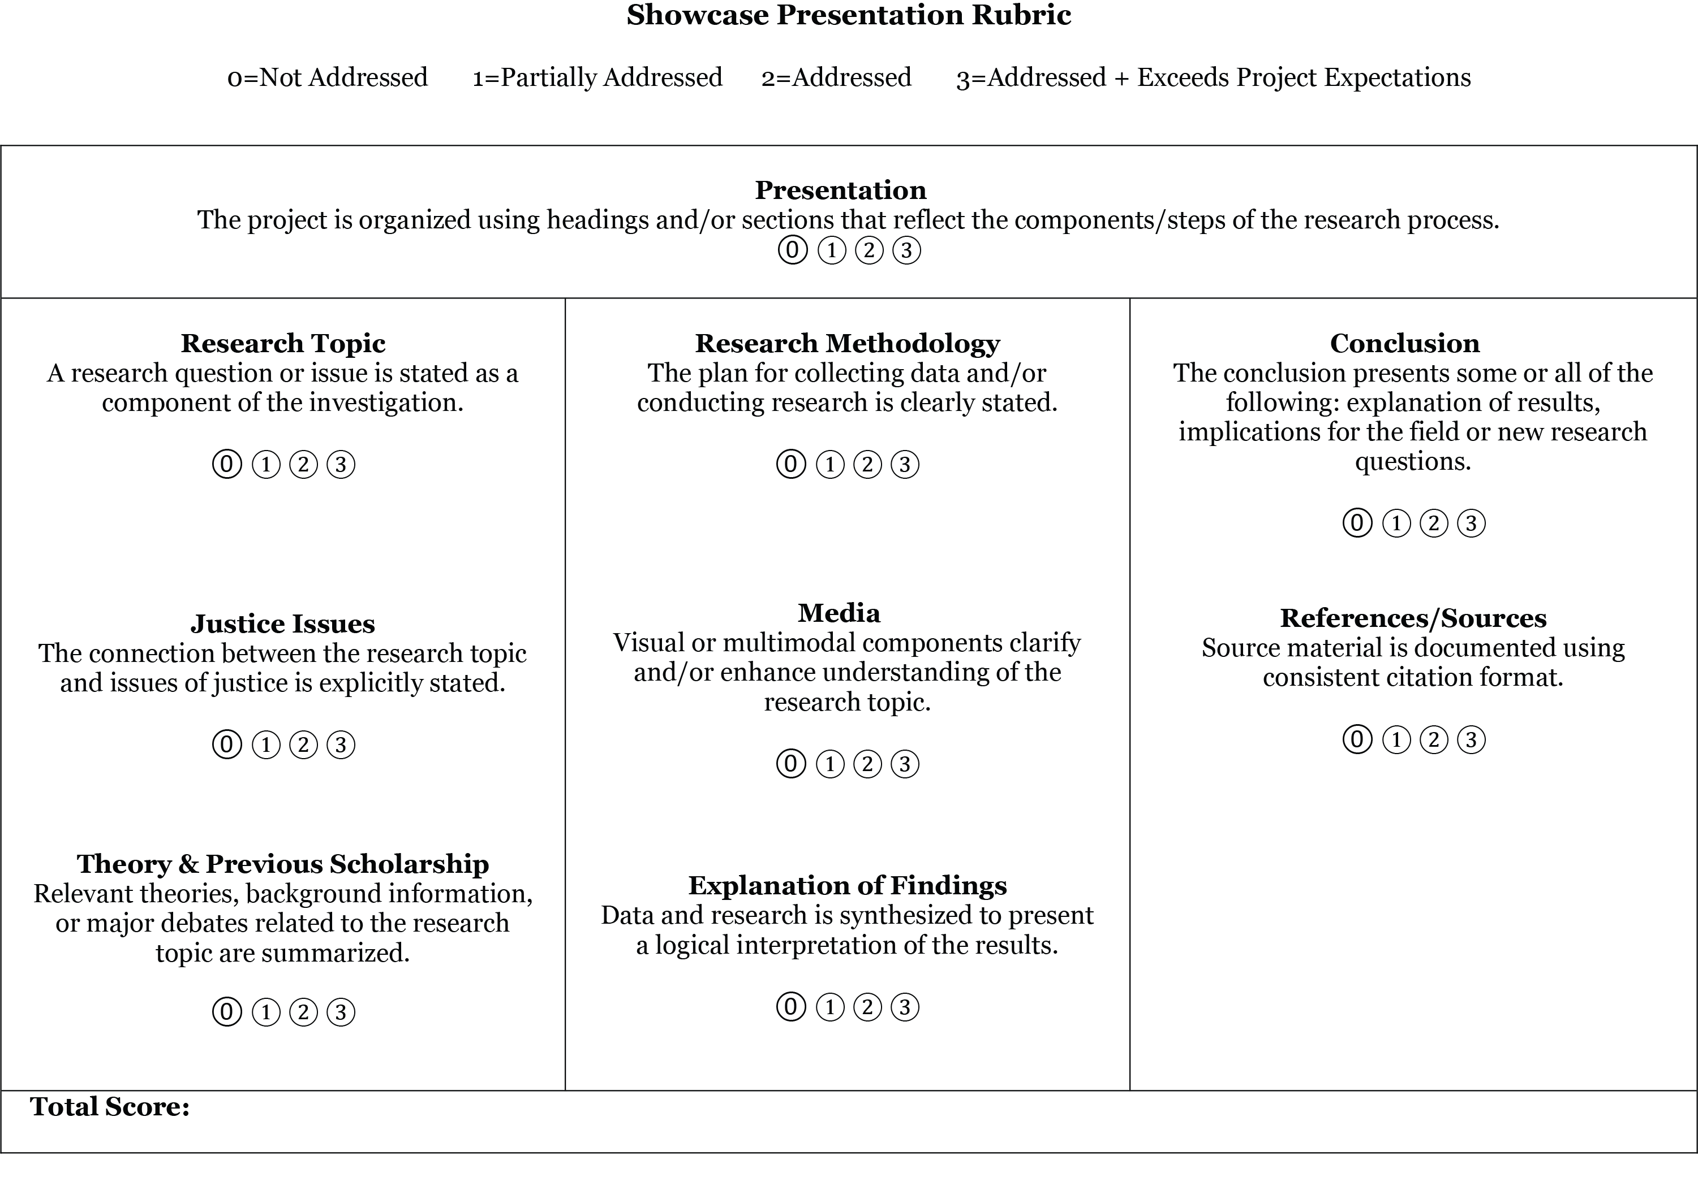

Slide 2
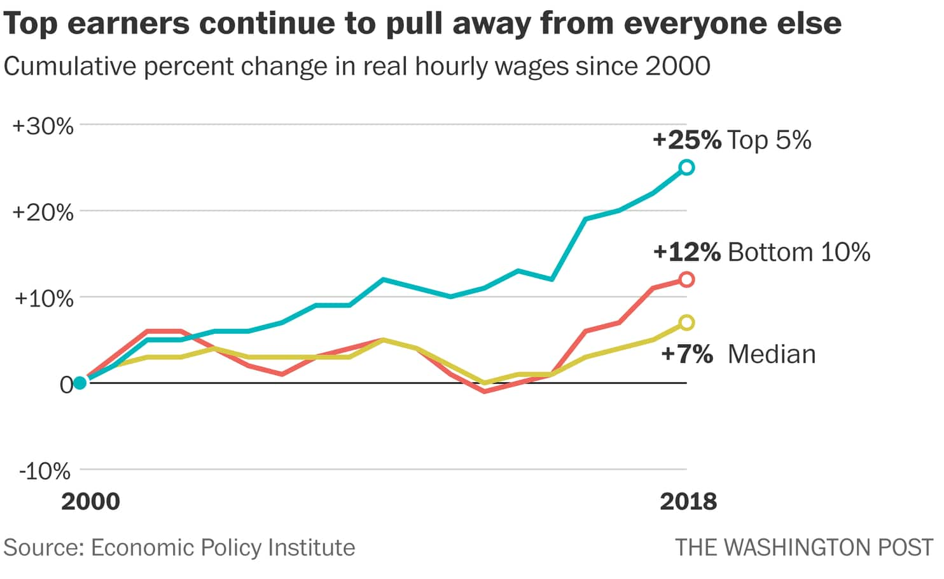
Title of your poster goes here (1 line)
Marcia Smith, Jim Rodriguez, Alice Jones, William Lee
FY03 ECO 101, Professor John Stevens
Purpose/Question
Methods
Images/Charts
Conclusion and Connection to Justice Issues
Use this space to introduce your project. If applicable, pose a question which your research will explore. State your purpose or goals, and provide an overview of research.
Don’t feel limited by the headings above; choose the one which supports your project best.
Describe your research process, highlight key information or data, or introduce source material related to your research question.¹
Explain the relevance of your findings to justice issues; consider connections between findings and your research question or purpose; or, present new questions or ideas for future research.
Tip: Before you submit your poster, evaluate your work using the rubric.
Be sure to include citations for ALL images, charts, and graphs that you did not create on your own.
Supporting Evidence/Theories
Findings
Images/Charts
Present and interpret your findings; explain the relationship between findings and your research question. Identify any challenges with sources used, your methodology, or research design.
Introduce prior research/scholarship, definitions, background information, or key concepts.
References
Use APA format. Present your sources in the order they appear using superscript. See example below:
^{1.} Student Academic Success Programs. (2014) Evaluation and presentation: Guidelines for poster preparation. Retrieved from: http://johnjay.jjay.cuny.edu/files/academics/Editing.pdf . October 5, 2017.
Be sure to include citations for ALL images, charts, and graphs that you did not create on your own.

